Slide 1
BZ350 Recitation Week 10
T.A. info:
Chris deRoux (day-ROO)
Any/all pronouns
Chris.deRoux@colostate.edu
Office Hours: Every Friday 10AM-12PM in Bio 355
Itinerary:
Announcements
Replication Review
Sample Problems

Slide 2
Announcements
Problem Set 8: No longer due Mar 27. 15/15 for everyone regardless of submission.
Genetics in the News: 5 points extra credit. Email me to claim a slot.
Exam 2: Should get back to you Friday.
Recitation format change: Recitations will now cover material ahead of Problem Sets.

Slide 3
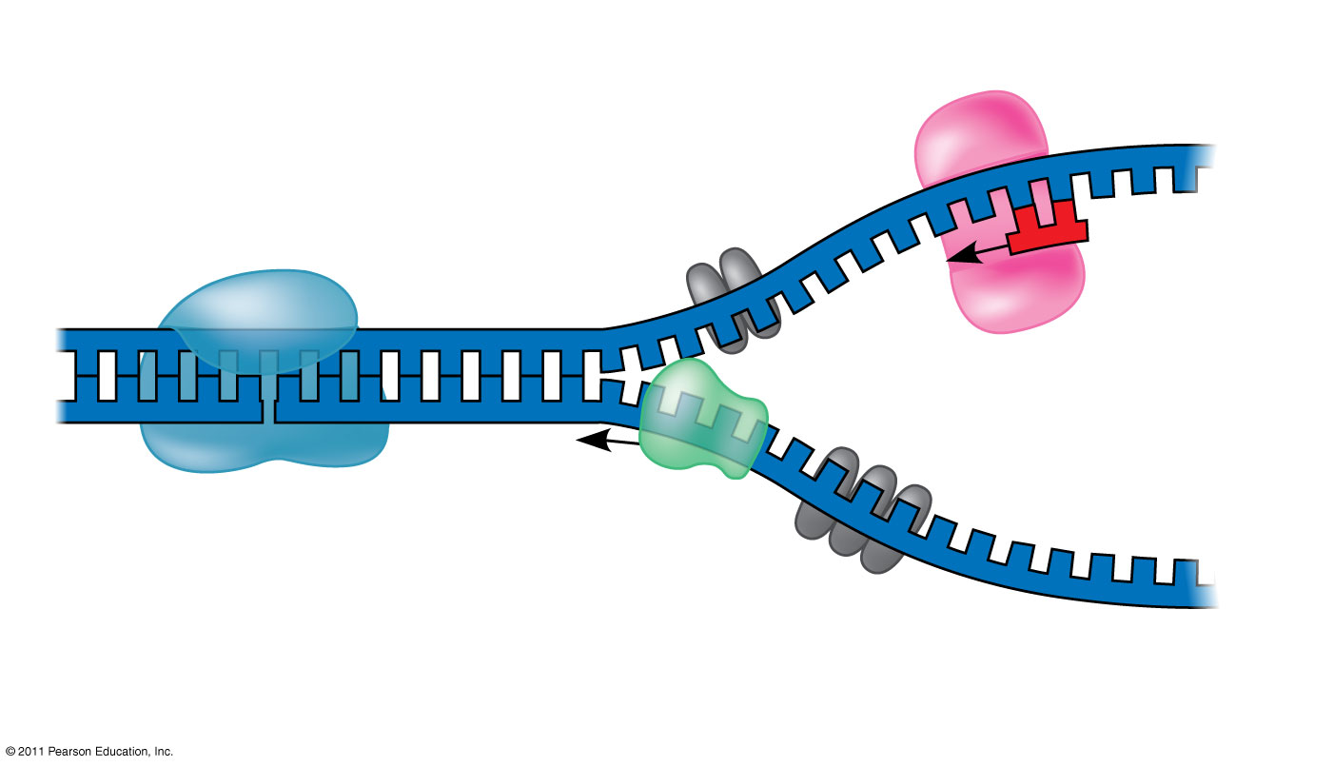
Replication Initiation
Makes RNA primer
Primase
Cleaves DNA to relieve supercoiling
3′
Topoisomerase
5′
RNA primer
3′
5′
3′
Helicase
Unwinds DNA
5′
Single-strand binding proteins
Notes:
Replication Fork - Y-shaped region at the end of replication bubble where new DNA strands elongating
Helicases - enzymes that untwist the double helix at replication forks
Single-strand binding proteins - bind to and stabilize single-stranded DNA
Topoisomerase - corrects “overwinding” ahead of replication forks by breaking, swiveling, and rejoining DNA strands

Slide 4
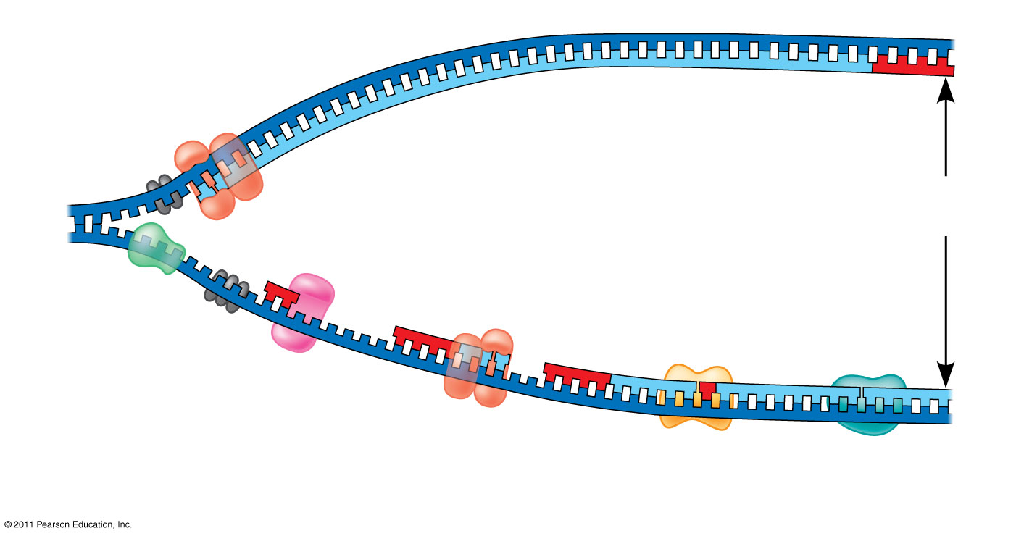
Bacterial DNA Replication
DNA pol III synthesizes leading strand continuously
3′
5′
Parental DNA
DNA pol III starts DNA synthesis at 3′ end of primer, continues in 5′ → 3′ direction
Origin of replication
5′
3′
5′
Lagging strand synthesized in short Okazaki fragments, later joined by DNA ligase
Helicase
Primase synthesizes a short RNA primer
3′
5′
DNA pol I replaces the RNA primer with DNA nucleotides
Notes:
HPOTL

Slide 5
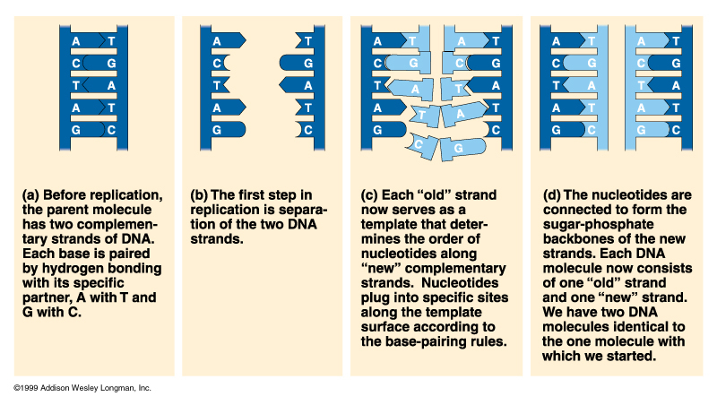
DNA replication is “Semi-Conservative”
DNA strands
separate;
each strand
serves as a
template for
new strand
New
strands
are made
from
nucleotides
Each DNA
molecule
is 1/2 old,
1/2 new

